Slide 1
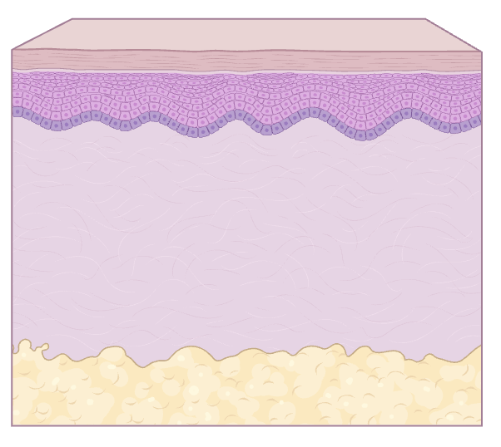
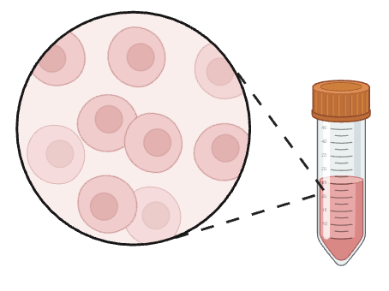
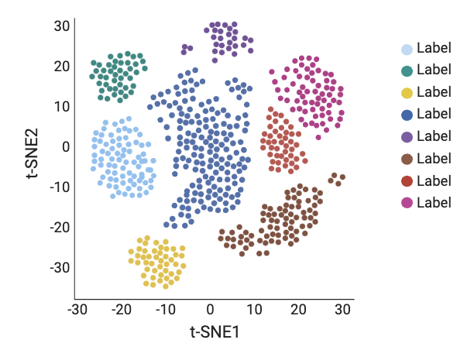
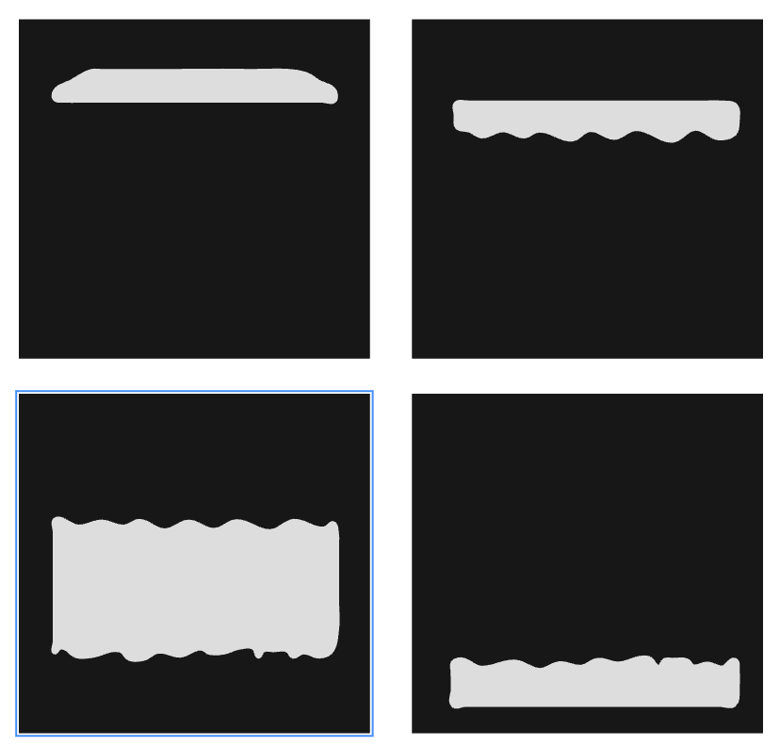

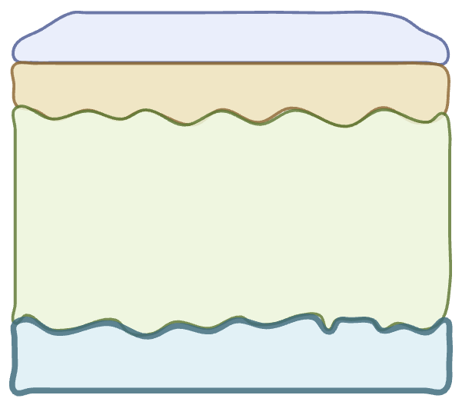

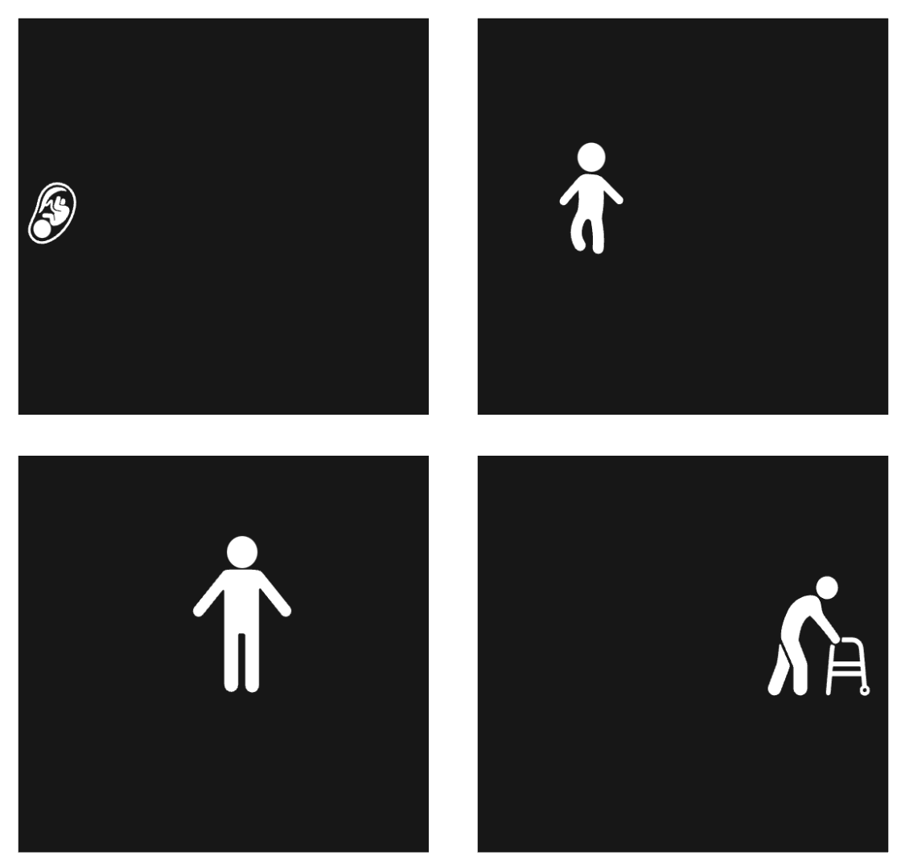
Data collection
Create cell suspensions and sequence data
Scatterplot visualisation and downstream analysis
Classical pipeline
Determine ROIs
Create representative masks depending on metadata wish to view
Select masks and plot different types of metadata or gene expression for each section
Layer 1
Optional additions
Layer 2
Gene expression
Number of counts for a value
% of counts within a section
% of counts across sections
Layer 3
Anatomical loci
Sex
Layer 4
If using data which can be cut into ROIs separate into individual sections for separate cell suspensions
Donor
Age

